Slide 1
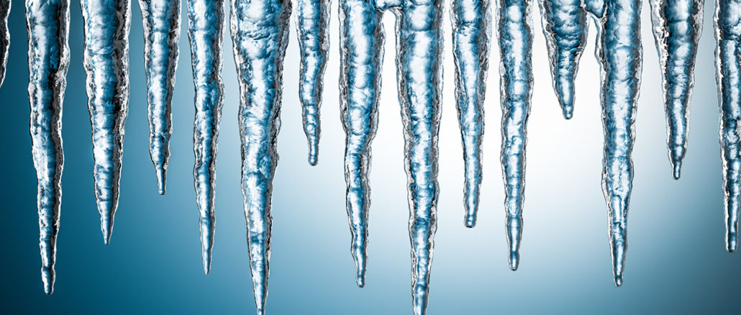
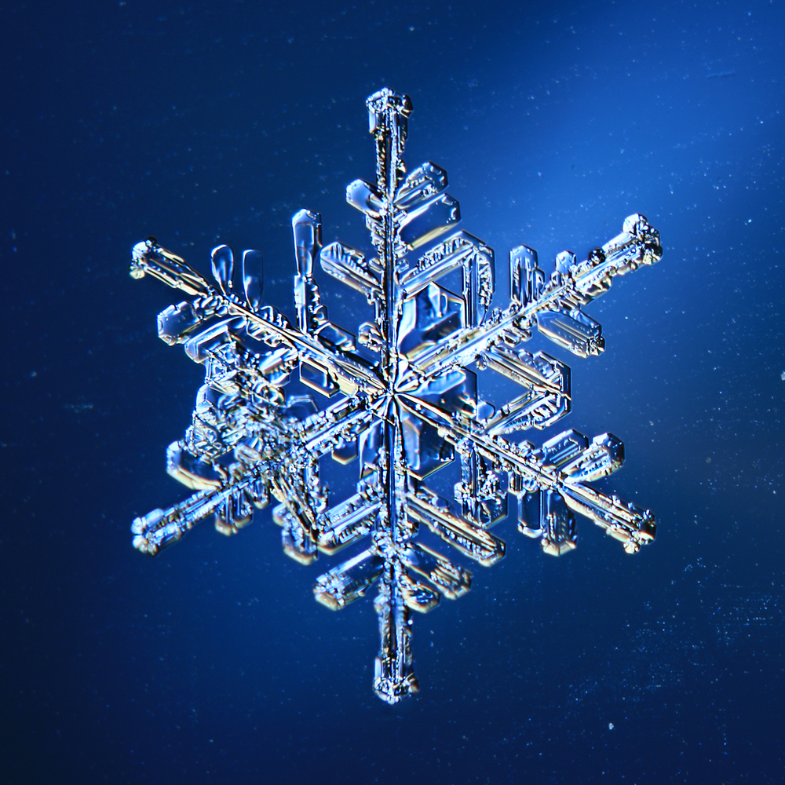
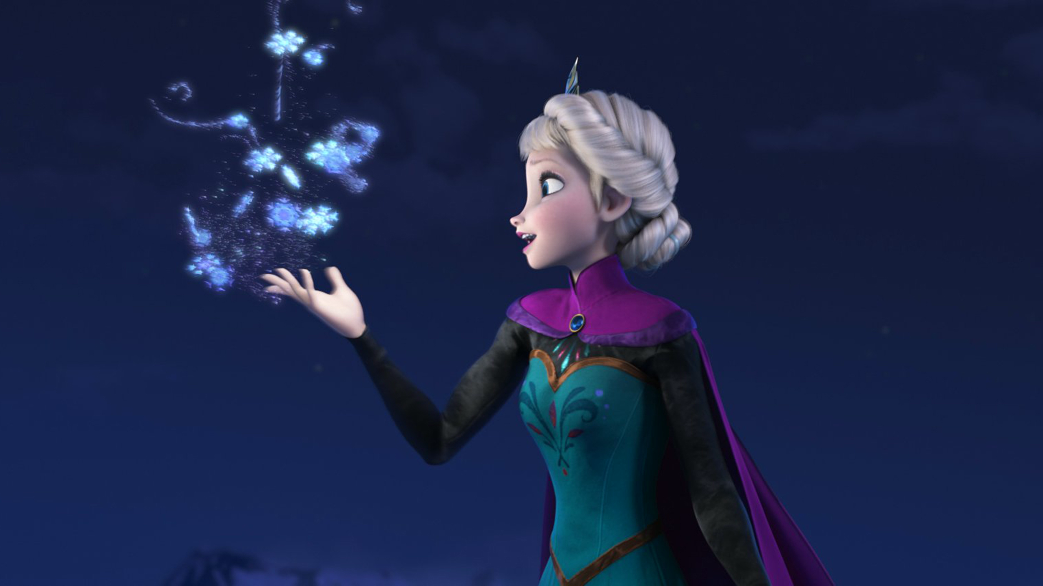
Ice Ice Baby
SCA Lesson Week 3
By: Mr. Chris and Miss Emily

Slide 2
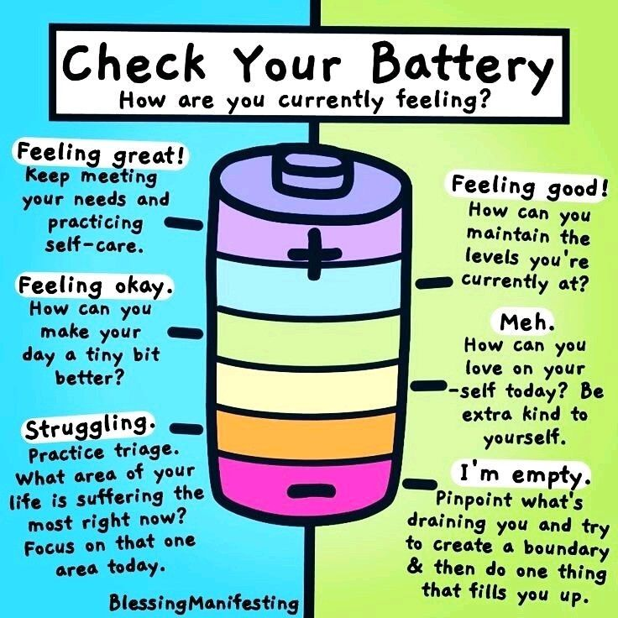
Start-Up Activity
How are you feeling today?
1 2 3 4

Slide 3
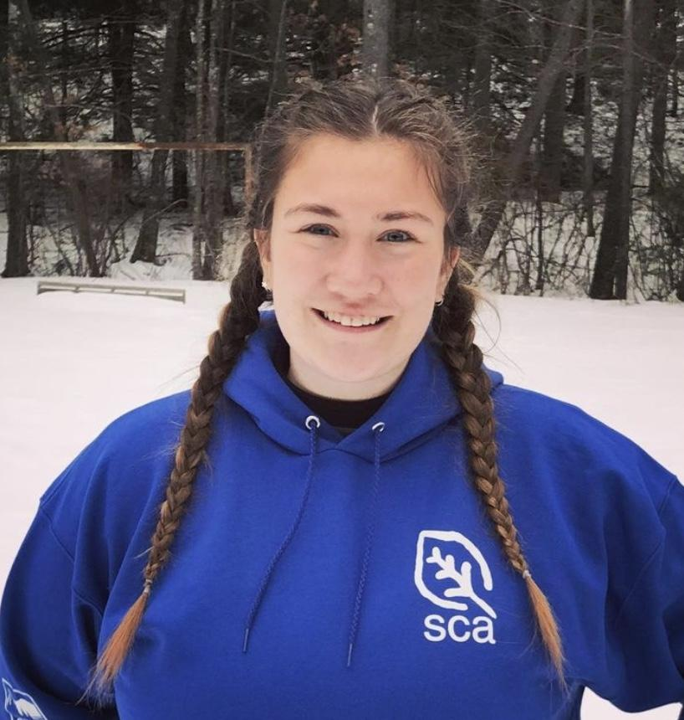
Snow and Ice Recorded Video
https://www.loom.com/share/b78d48ed990c46668dd3407bbb43f594

Slide 4
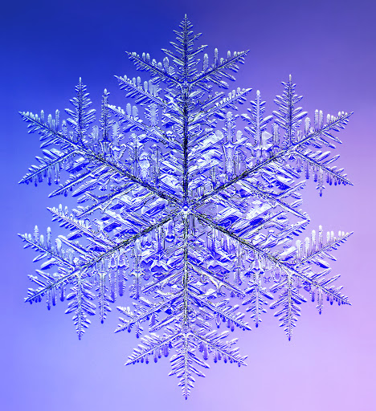
See how temperatures affect a snowflakes growth
Grow Snow Crystals
Please Click the Link Above

Slide 6
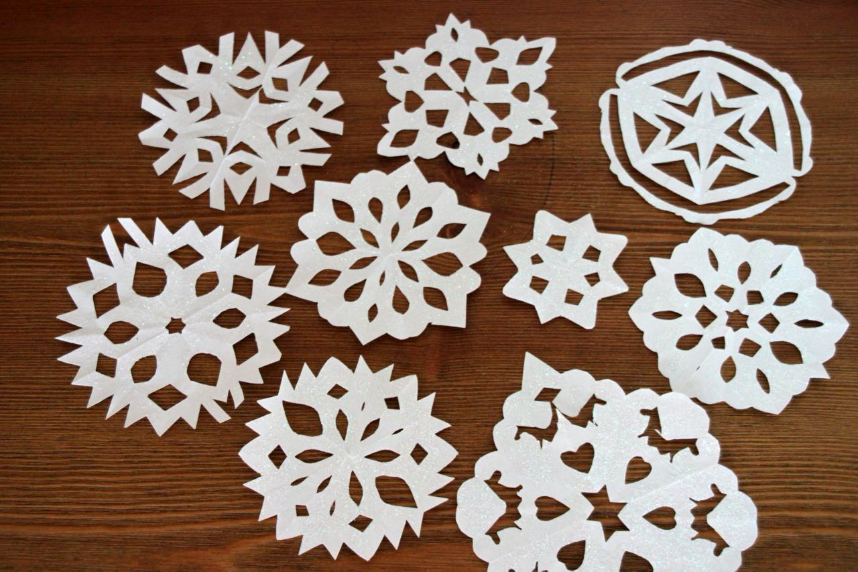
Snowflake activity
For this activity, you will need a piece of plain paper and a pair of scissors
If you don’t have plain paper, colored or lined paper will also work
https://www.loom.com/share/04116530ada24d0386cf390106cbd11c

Slide 7
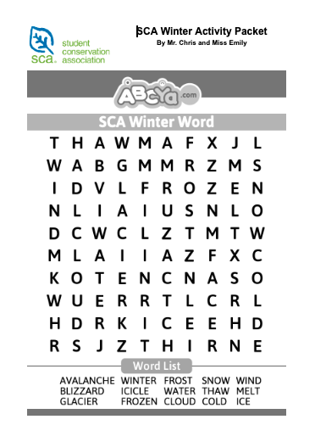
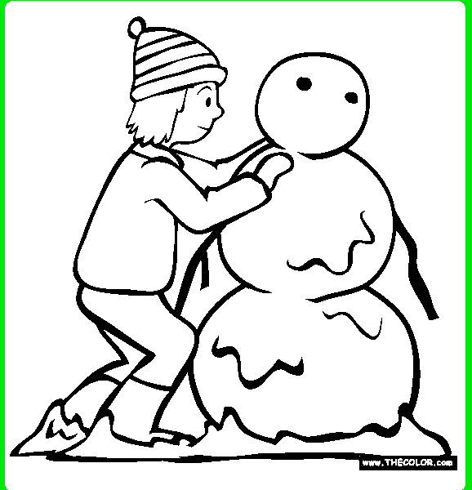
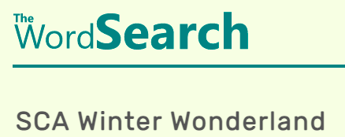
Activity packet
Online Option
https://www.thecolor.com/Coloring/Snowman1.aspx
https://thewordsearch.com/puzzle/2006737/sca-winter-wonderland/
Printed Option
https://docs.google.com/document/d/1Cc0izyRnJW8tZT97_2nHsL9r0c4Q9fb4nShyP79ewnw/edit?usp=sharing

Slide 8
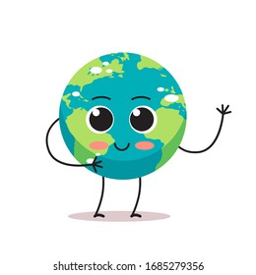
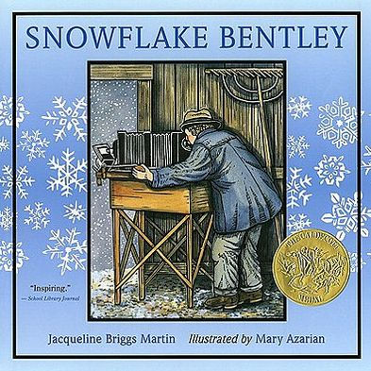
Earth Pledge
Recommended Book for further reading on snowflakes
Join us in the Earth Pledge!

